Slide 1
HTML
HYPER TEXT MARKUP LANGUAGE

Slide 2
TERMS TO KNOW BEFORE STARTING HTML:
Internet
Web page
Websites
Web browser
Web server

Slide 3
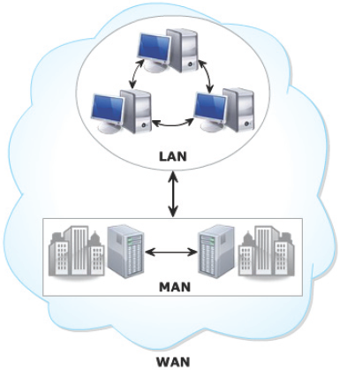
Network
Group of two or more computers linked together
^{Local Area Network (LAN)}
Metropolitan Area Network (MAN)
^{Wide Area Network (WAN)}

Slide 4
Network
Network in a small geographical area
Network that covers city
Network that connects LANs and MANs across the globe
Back to internet

Slide 5


INTERNET:
The Internet is a global network connecting millions of computers.
All countries are linked into exchanges of data, news and opinions.
Back to Intro

Slide 6
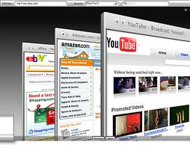
WEB PAGE
a file usually written in HTML that can be read by a Web browser.
Back to Intro

Slide 7



A WEB BROWSER
Browsers are basically software programs that allow you to search for and view various kinds of information on the Web, such as web sites, video, audio, etc.
Back to Intro

Slide 8

A WEBSITE :
A Website is a collection of documents known as WebPages.
The main page in a website is called a homepage, and other pages in a website are called subpages. These are connected by hyperlinks.
Back to Intro

Slide 9
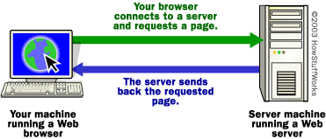
A WEB SERVER:
Starting HTML
The primary function of a web server is to deliver web pages on the request .

Slide 10
Introduction to
HTML

Slide 11
HTML(Hypertext Markup Language)
HTML is a language for describing web pages.
HTML is the language which browser understands.

Slide 12
HTML
What is HTML
HTML = Hypertext Markup Language
Hypertext allows for “hyper linking”
Hypertext is text with hyperlinks
Markup: Text is “marked” using HTML tags
HTML tags tell the browser how to structure the information on the page
Notes:
Writing HTML using XML rules allows you to make less mistakes, and prepares you to start writing web pages using the XHTML standard.
Some differences between XML and HTML are
HTML is not case sensitive
Not all HTML tags need an end tag
HTML tags are predefined to structure the document in certain ways. For example in HTML tags <p> means start a new paragraph.

Slide 13
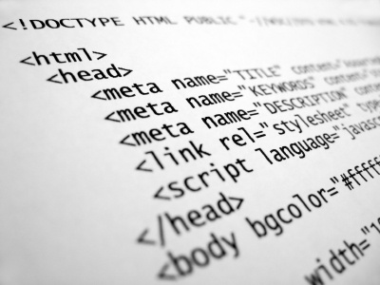
Hyper text markup language
Hypertext is simply a piece of text that works as a link. A Markup Language is a set of markup tags

Slide 14
Remember!
HTML tags are keywords surrounded by angle brackets like <html>
HTML tags normally come in pairs like <b> and </b>
The first tag in a pair is the start tag, the second tag is the end tag
Start and end tags are also called opening tags and closing tags

Slide 15
Structure of html document:
<html>
<head>
</head>
<body>
</body>
</html>
tags

Slide 16
Basic structure:
<html>
<head>
</head>
<body> - - - - - - - - - -
- - - - - - - - - -
</body>
</html>
Document
Information(not visible in webpage) i.e. needed for server
Page
content

Slide 17
Marking elements with tags
Two-sided tag(container tags): A tag that contains some document content.
<element> content </element>
Opening tag
Closing tag
One-sided tag (standalone tags) A tag that contains no content. They are also called empty elements since they contain no content.
<element />

Slide 18
HEAD section
The <head> element is a container for all the head elements. Elements inside <head> can include scripts, instruct the browser where to find style sheets, provide meta information, and more.

Slide 19
BODY section
Page content
Includes text, images, links, forms, etc.
Elements include backgrounds, link colors and font faces
P element forms a paragraph, blank line before and after

Slide 20
<Head> Section:
<html>
<head>
<title>My First HTML Document</title>
</head>
<body>
</body>
</html>

Slide 21
<BODY> Section:
Paragraphs:
HTML documents are divided into paragraphs.
<P> tag forms a paragraph, blank line before and after.
Headings
Simple form of text formatting
Vary text size based on the header’s “level”(h1,h2,h3,h4,h5,h6).
Can vary significantly between browsers

Slide 22
<html>
<head>
<title> My 1st page</title>
</head>
<body>
<h1> Hello world </h1>
<p> This is First Paragraph </p>
</body>
</html>

Slide 23
Levels of Heading tag:
<h1> .. </h1> Largest
<h2 > .. </ h2>
<h3 > .. </ h3>
<h4 > .. </ h4>
<h5 >.. </ h5>
<h6 > .. </ h6> Smallest

Slide 24
EXAMPLE HEADINGS:
<html>
<head>
</head>
<body>
<center>
<h1> Level 1 Header </h1>
<h2 > Level 2 Header </ h2>
<h3 > Level 3 Header </ h3>
<h4 > Level 4Header </ h4>
<h5 > Level 5 Header </ h5>
<h6 > Level 6 Header </ h6>
</center>
</body>
</html>

Slide 25
Nesting
<head>
<title>
Learning HTML
</title>
</head>
The technique of placing one element within another element is called NESTING.

Slide 26

Nesting
When one element contains another, you must close the inside element before closing the outside element.
<head>
<title>
Learning HTML
</title>
</head>
<head>
<title>
Learning HTML
</head>
</title>

Slide 27
Breaking Lines
<body>
<h1>Chapter 1</h1>
The
</br>
end.
</body>
This will force the two words to appear on separate lines

Slide 28
Text Styling
create italics using
special <I>effects</I>
which produces
special effects
create boldface using
special <B>effects</B>
which produces
special effects

Slide 29
Text Font Size
font size may be numbered using absolute values between 1 and 7
font size may be sized relatively using +n or -n (where n is some integer)
<FONT SIZE=7> X </FONT Size>
Produces
X

Slide 30
Special Text Effects
examples:
X<SUP>2</SUP>
produces
X²
T<SUB>1</SUB>
produces
T₁
<b><U>War and Peace</U></b> by Leo Tolstoy
produces
War and Peace by Leo Tolstoy
<FONT COLOR=“RED”>red text</FONT>
produces
red text

Slide 31
Text Styling
Underline style
<U>…</U>
Align elements with ALIGN attribute
right, left or center
Close nested tags in the reverse order from which they were opened
Emphasis (italics) style
<EM>…</EM>
Strong (bold) style
<STRONG>…</STRONG>
Notes:
Often <strong> renders as <b>, and <em> renders as <i>. <b> or <i> defines bold or italic text only. <strong> or <em> means that you want the text to be rendered in a way that the user understands as "important". Today, all major browsers render strong as bold and em as italics. However, if a browser one day wants to make a text highlighted with the strong feature, it might be cursive for example and not bold!

Slide 32
Example:
<html>
<body>
<p><b>This text is bold</b></p>
<p><strong>This text is strong</strong></p>
<p><i>This text is italic</i></p>
<p><em>This text is emphasized</em></p>
</body>
</html>

Slide 33
Attributes of Tags

Slide 34
Attributes of Tags:
“Attributes are the properties of tag.
Attributes give certain characteristics to a tag (e.g., height, width, color, etc.
Attributes are always specified in the start tag.
Attribute values should always be enclosed in quotes.

Slide 35
HTML Comments
Comments can be inserted into the HTML code to make it more readable and understandable. Comments are ignored by the browser and are not displayed.
Comments are written like this:
<!-- This is a comment -->

Slide 36
Editing HTML
HTML files or documents
Written in source-code form using text editor
Notepad: Start-Programs-Accessories
HTML files
.htm or .html extensions
Name your files to describe their functionality

